Slide 1
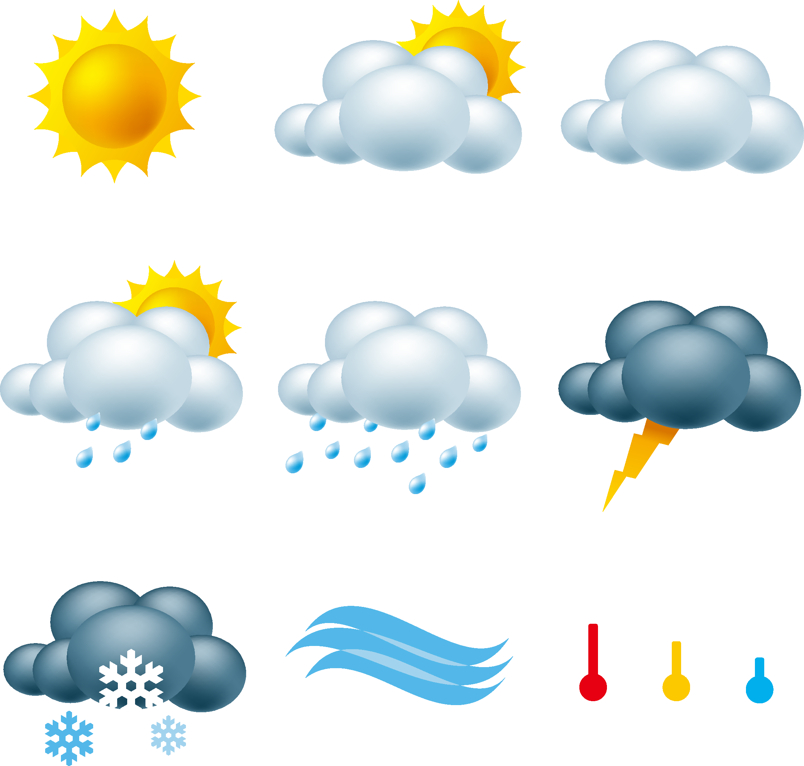
Weather Forecast
Lorenzo Leighton
A lightweight Python program for quickly checking weather information in a given area.

